Slide 1
Media Player
By:
IIT2019211 - Divy Agrawal
IIT2019210 - Aditya Aggarwal
IIB2019017 - Ambika Kaushik

Slide 2
Roadmap
Basic Concept
About Our Project
UML Diagram
About Diagrams and Relationships
Functionalities,
Main Dependency, Relationship
Use Case, CRC, Class Diagram

Slide 3
Basic Concepts
Let’s first discuss about UML Diagrams

Slide 4
UML Diagram
Use Case Diagram
Describe what a system does from the standpoint of an external observer. The emphasis is on what a system does rather than how.
Contains
Use Case
Actors
The System Modeled
Use
Determining features (requirements)
Notational simplicity makes use case diagrams a good way for developers to communicate with clients
Generating test cases
CRC Diagram
Describes the functionality of various classes present in the application. Also tells that which classes in the system are in collaboration.
Contains
Class Names
Class Responsibilities
Class Collaborations
Use
Helps in designing class diagram
Class responsibilities are the attributes and operations of the class
Used by developer and application domain expert
Class Diagram
Describes the attributes and methods of the class and the constraints imposed on the system. Provide the static view of the project.
Contains
Class Names
Class Attributes
Class Operations
Use
Forward and Reverse Engineering
Analysis and design of the static view of the application
Used by developer and application domain expert

Slide 5
Relationship Types
Represents “is-a” relationship
The child classes “inherit” the common functionality defined in the parent class.
A special type of association. It represents a "part of" relationship.
Objects of both classes have separate lifetimes.
A solid line with an unfilled diamond connecting two classes.
Is a directed relationship
Used to show that some UML element or a set of elements requires, needs or depends on other model elements for specification or implementation
Association
Composition
A structural link between two peer classes.
A solid line connecting two classes.
A special type of aggregation where parts are destroyed when the whole is destroyed.
A solid line with a filled diamond connecting two classes.
Generalization
Aggregation
Dependency

Slide 6
About our project
Functionalities, Main Dependency, Future Scope

Slide 7
Project Tasks
To create a simple media player
A positioning slider to jump to certain points in the media clip.
A play/pause button.
A volume button that provide volume control.
A media properties button that provides detailed media information
Frame rate control.
To play media from any location
Set speed for playing media.
One to one Relationship - a user could open only one media player window and play a media.

Slide 8
Dependency
The whole functionality of the player depends upon:
Open button which will fetch the media path and load it.
Media playing in the player
The media player supports media of some specific extensions only like: mp3, mp4, wav, FLV, so, this is one of the major dependency of the media.

Slide 9
Further Extension
We can add a button for recording which can provide good quality with less video size.
We can add an option of creating a playlist in which we can select multiple videos at a single time.
We can add an option of adding subtitles in the player.
We can add an option of opening more types of media with different extensions.

Slide 10
UML Diagram
Use Case, CRC, Class Diagram

Slide 11
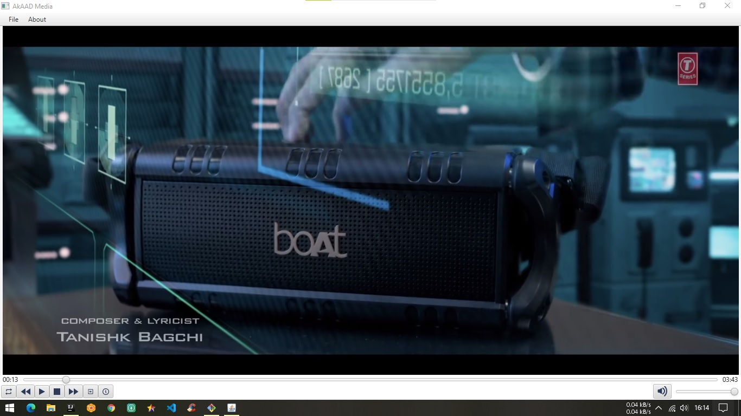
DEMO

Slide 12
Thank You

